Slide 1
Digital Media Technology Week 8: Data Criticism and Tool Criticism

Slide 2
General aims of DMT
Develop some affinity with coding
Building up confidence with digital technologies
Jerome McGann’s notion “imagining what we do not know”
Invent creative applications of technology

Slide 4
Solutionism

Slide 5
Data are created by human researchers
Flanders and Jockers note that “tools bring the data into existence, not just into view”. Cf. Johanna Drucker: From Data to Capta. Or perhaps: Facta or Constructa?

Slide 6
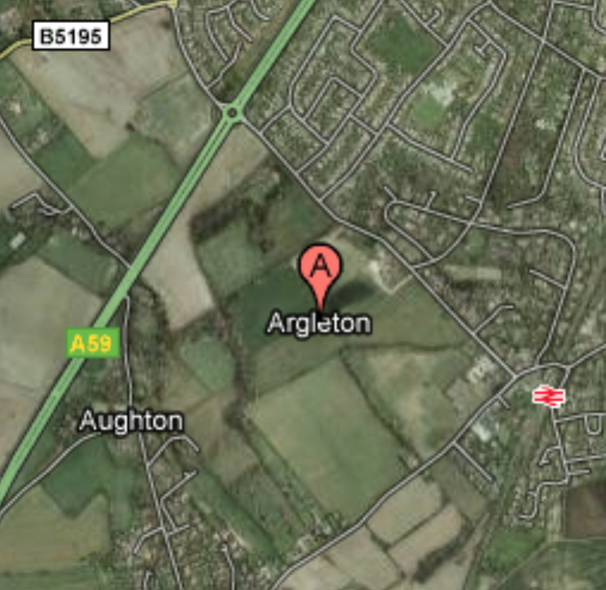


Data errors

Slide 7
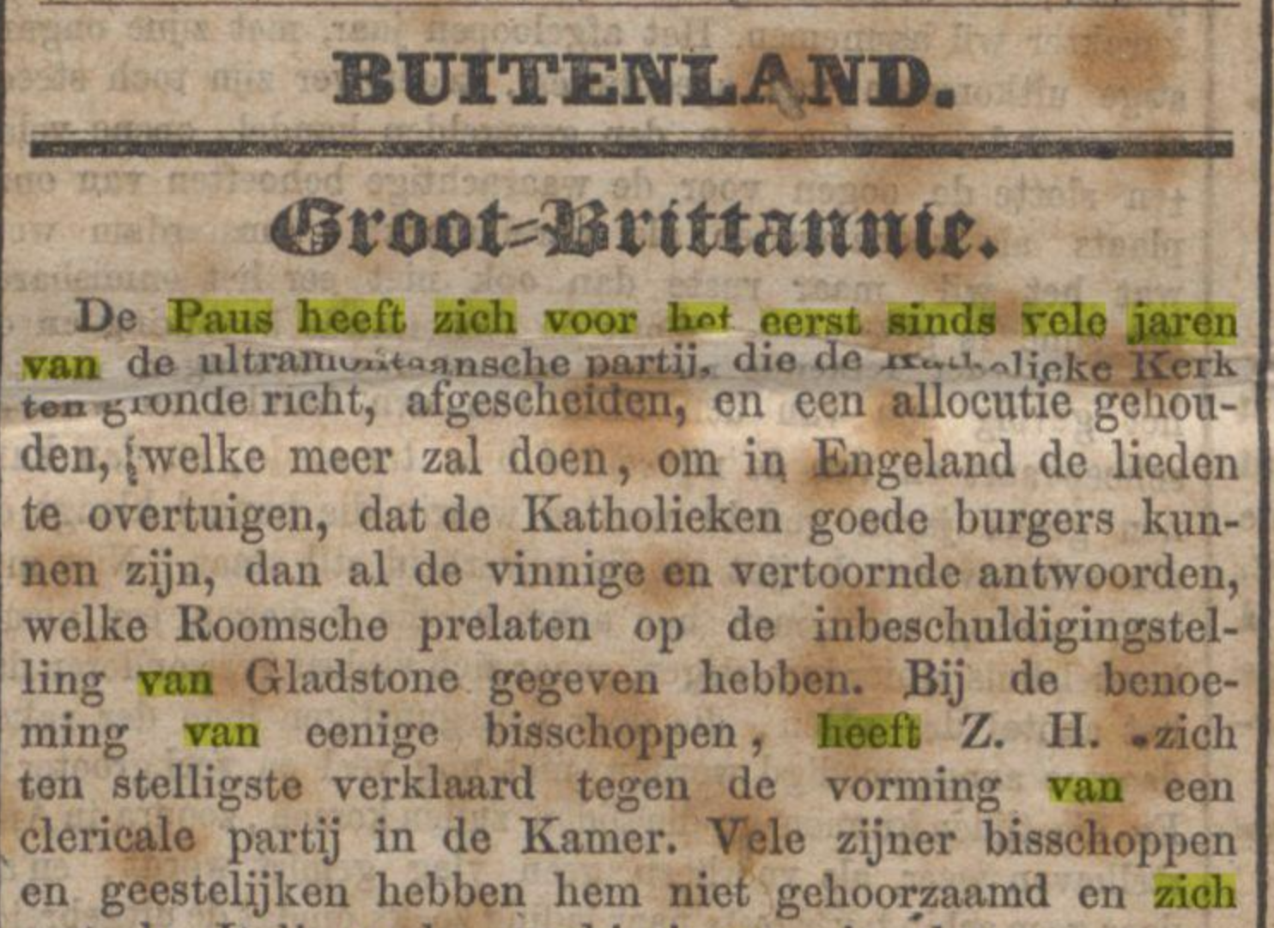
From sources to plain texts
Data criticism demands domain knowledge
Digital collections may be incomplete
Transcriptions may be of a low orthographic quality
BUITENLAND. Groot=Brittannie.
Dc Paus heeft zich voor Kot eerst sinds vele jaren van dc ultnuumitaansche aatti-i» die da __r_.ti. „i ipkjgfËMfrk urn gronde richt, afgesehflJßßÏf,

Slide 8
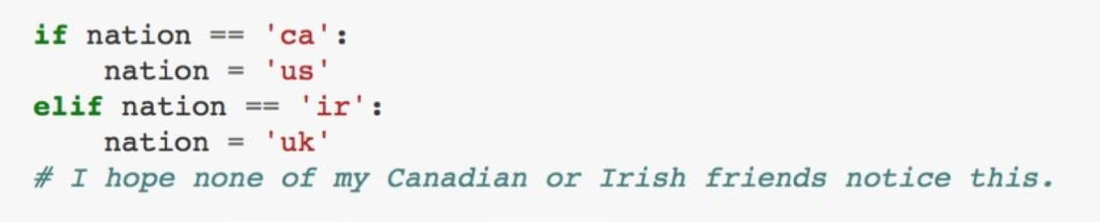
Captured data: raw data generated “through some form of measurement such as observation, surveys, lab and field experiments, record keeping […], cameras, scanners and sensors”.
Derived data: “produced through additional processing or analysis of captured data”.
Rob Kitchin, The Data Revolution, 2014

Slide 9
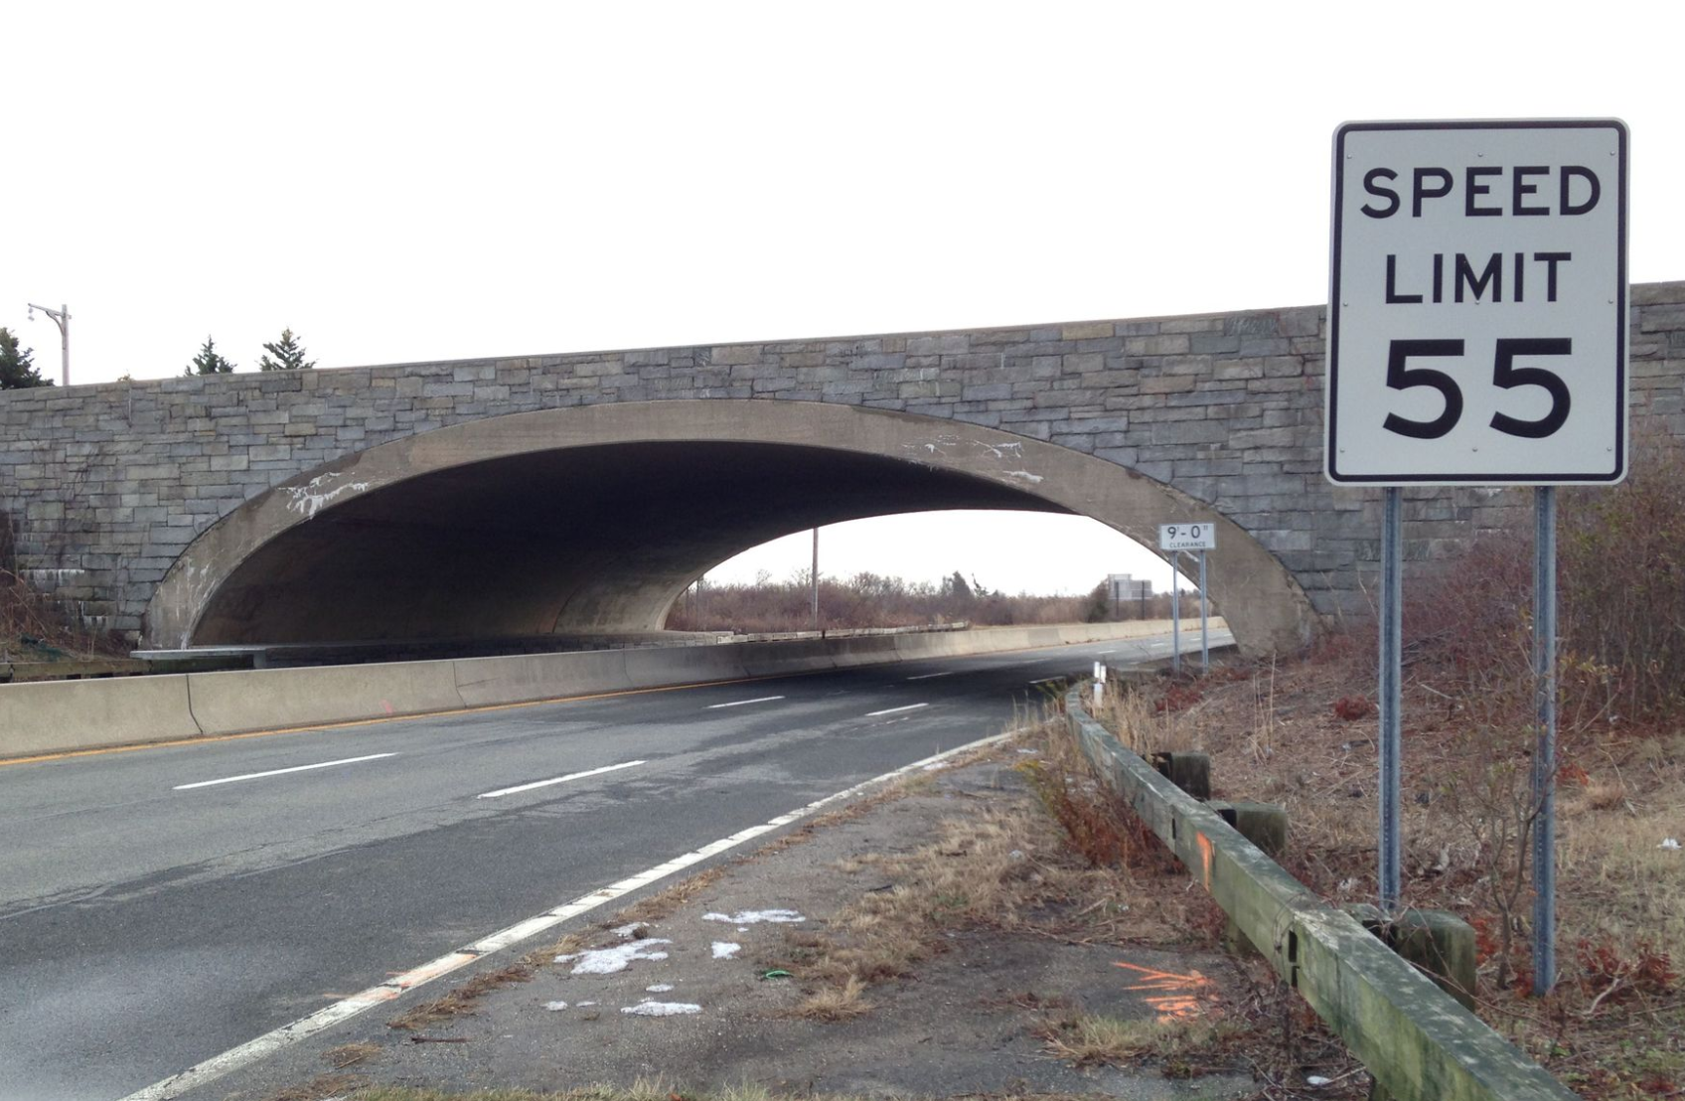
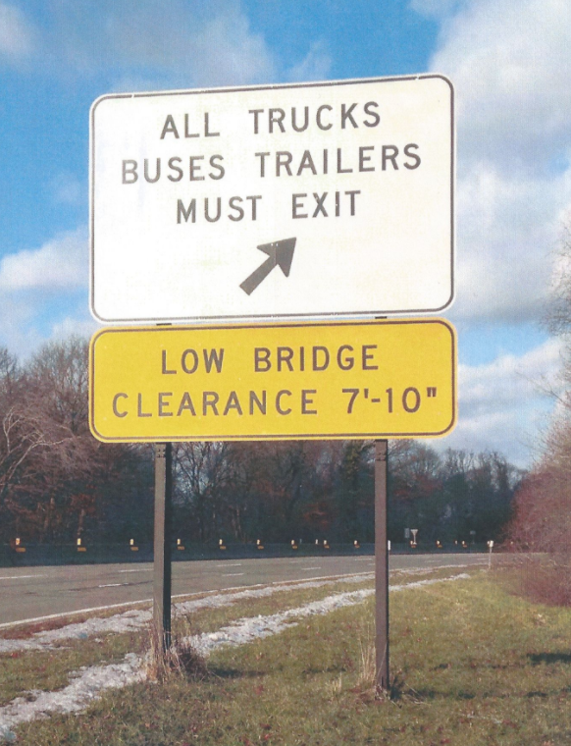
Langdon Winner, “Do Artefacts have Politics?”

Slide 11
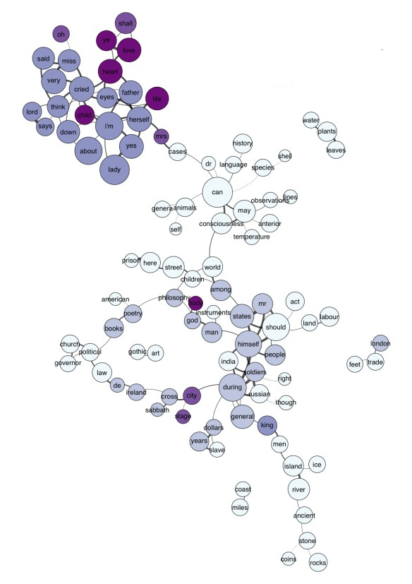
Subjectivity
Algorithms are created by human programmers
They reflect subjective views on how textual phenomena ought to be identified an on how they can be analysed

Slide 12
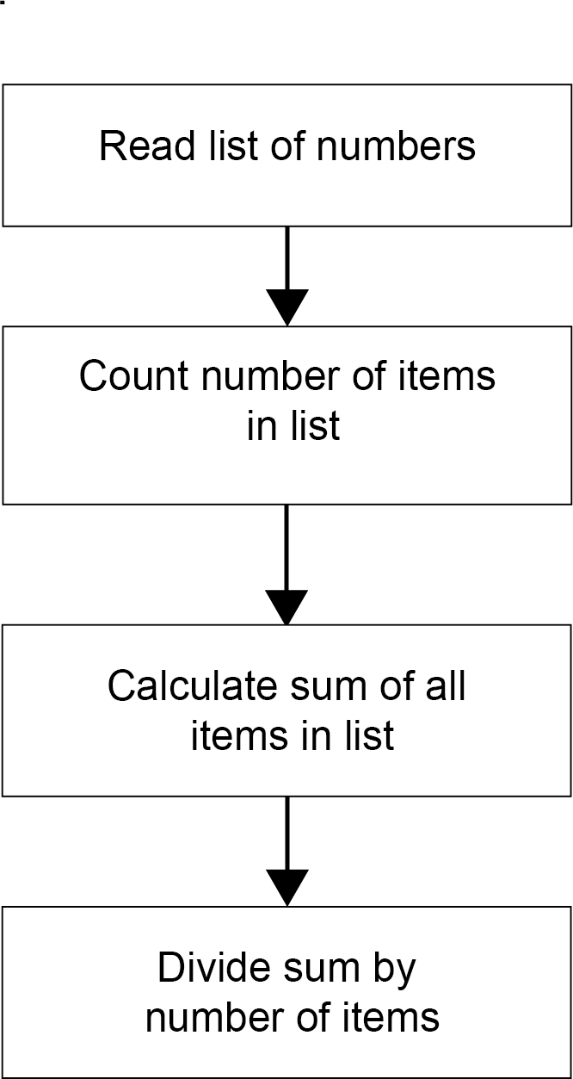
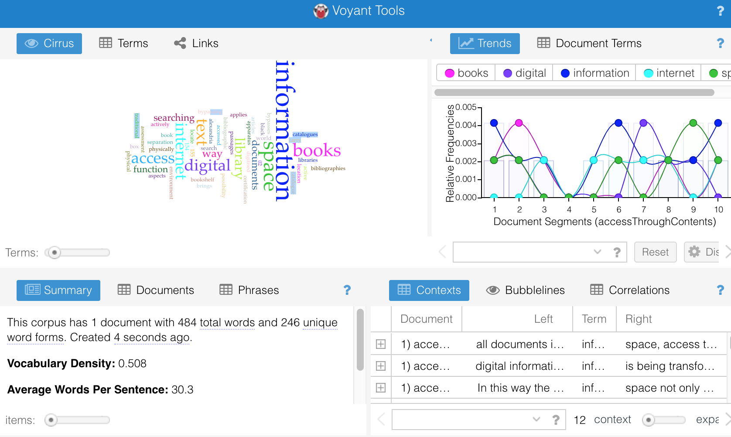
Opacity of algorithms
www.voyant-tools.org
Algorithm
Tools

Slide 13
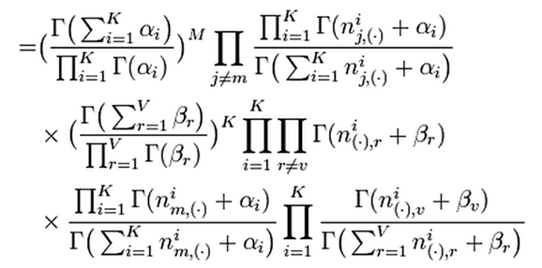
Algorithms and transformations
Data analysis is often based on highly complicated algorithms
Transformations are the “coherent goals” produced by tools and algoriths
E.g. Sorting algorithms
Benjamin Schmidt, “Do Digital Humanists Need to Understand Algorithms?”, in: Debates in the Digital Humanities, (Minneapolis: University of Minnesota Press 2016).

Slide 14
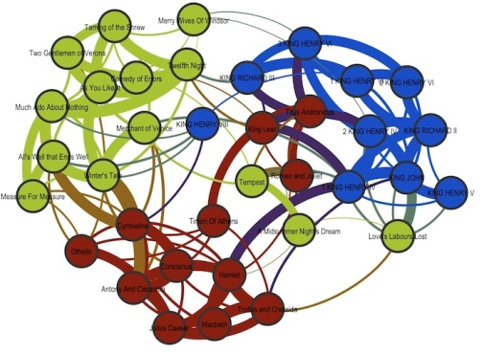
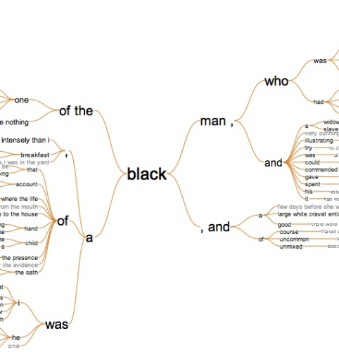
Data Criticism
Which flaws are in the data set?
What is the impact of these flaws?

Slide 15
Tool Criticism
Which transformation are effectuated by a tool/algorithm?
How well does the algorithm/tool perform this transformation?
Is the tool biased in any way?
Does the tools actually help me to answer a specific research question?

Slide 16
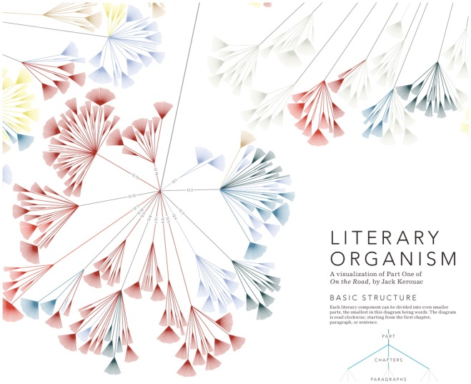
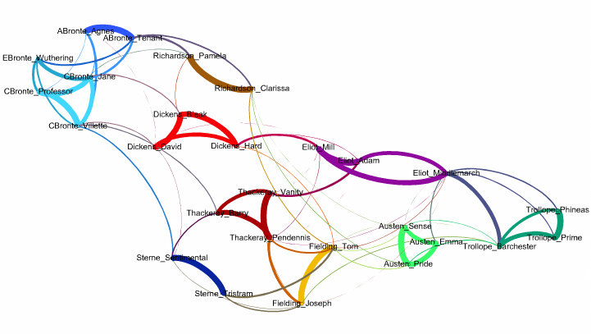
The main value for SSH lies in reambiguation and in the capacity to kindle new ideas
Analyses often have an aleatory or an exploratory aspect
Computer-assisted research forms an addendum and not an alternative to traditional scholarship

